Slide 1
Network Security

Slide 2
The Internet Protocol Suite
Set of protocols used to transport data between nodes of a network
Also known as the TCP/IP Protocol Suite
Based on abstraction and encapsulation
Link protocols
Internet protocols
Transport protocols
Application protocols

Slide 3
TCP/IP Layering
HTTP
SMTP
DNS
NFS
Application
TCP
UDP
Transport
IGMP
IP
ICMP
Internet
ARP
Hardware Interface
RARP
Link
Physical Layer

Slide 4
IP Addresses
Each host has one or more IP addresses for each network interface
IPv4 addresses are composed of 32 bit
Represented in dotted-decimal notation: 128.111.48.69
Initially divided in classes:
Class A (0): netid=7 bit (128 networks, actually 1-126), hostid=24 bit (16,777,216 hosts)
Class B (10): netid=14 bit (16384 networks), hostid=16 bit (65536 hosts)
Class C (110): netid=21 bit (2097152 networks), hostid=8 bit (256 hosts)
Class D - Multicast (1110): multicast addresses
Class E (1111): reserved or future use

Slide 5
Classless Inter-Domain Routing (CIDR)
Allocation of large chunks of IP addresses to single organizations wasted an enormous number of IP addresses
The public IPv4 space has been exhausted in February 2011
CIDR, introduced in 1993, is an addressing scheme which allows for more efficient allocation of IP addresses than the old class-based address scheme
The netid/hostid boundary can be placed on any bit between 13 and 27
32 hosts minimum
524,288 hosts maximum

Slide 6
Special Addresses
As source and destination address
Loopback interface: 127.X.X.X (usually 127.0.0.1)
As source address
netid=0, hostid=0 or hostid=XXX: this host on this net (used in special cases, such as booting procedures)
As destination address
All bits set to 1: local broadcast
netid + hostid with all bits set to 1: net-directed broadcast to netid
Reserved addresses (RFC 1597):
10.0.0.0 - 10.255.255.255
172.16.0.0 - 172.31.255.255
192.168.0.0 - 192.168.255.255

Slide 7
Internet Protocol (IP)
The IP protocol represents the “glue” of the Internet
The IP protocol provides a connectionless, unreliable, best-effort datagram delivery service (delivery, integrity, ordering, non-duplication, and bandwidth is not guaranteed)
IP datagrams can be exchanged between any two nodes (provided they both have an IP address)
For direct communication IP relies on a number of different lower-level protocols, e.g., Ethernet, FDDI, RS-232

Slide 8
IP Datagram
0
4
8
12
16
20
24
28
31
Version
HL
Service type (TOS)
Total length
Identifier
Flags
Fragment offset
Time To Live
Protocol
Header checksum
Source IP address
Destination IP address
Options
Padding
Data

Slide 9
IP Header
Normal size: 20 bytes
Version (4 bits): current value=4 (IPv4)
Header length (4 bits): number of 32-bit words in the header, including options (max header size is 60 bytes)
Type of service (8 bits): priority (3 bits), quality of service (4 bits), and an unused bit
Total length (16 bits): datagram length in bytes (max size is 65535 bytes)
Id (16 bits): unique identifier for the datagram (usually incremented by one)

Slide 10
IP Header
Flags (3 bits) and offset (13 bits): used for fragmentation
Time To Live (8 bits): specifies the max number of hops in the delivery process
Protocol (8 bits): specifies the protocol encapsulated in the datagram data (e.g., TCP)
Header checksum (16 bits): checksum calculated over the IP header
Addresses (32+32 bits): IP addresses of the source and destination of the datagram

Slide 11
IP Options
Variable length
Identified by first byte
Record route: each router records its IP address
Time stamp: each router records its IP address and time
Source route: specifies a list of IP addresses that must be traversed by the datagram
Many others…

Slide 12
IP Encapsulation
IP header
IP data
Frame header
Frame data

Slide 13
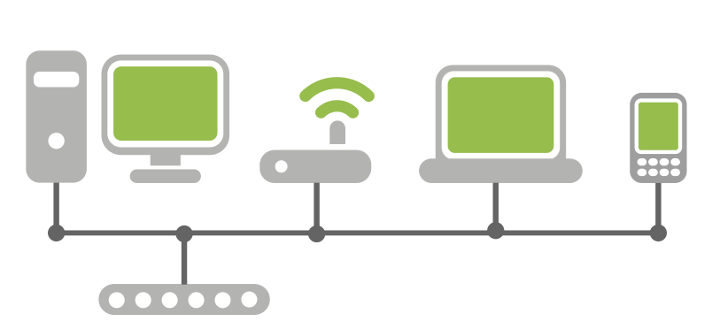
IP: Direct Delivery
If two hosts are in the same physical network the IP datagram is encapsulated in a lower-level protocol and delivered directly
Subnetwork 111.10.20
111.10.20.121
111.10.20.14
From 111.10.20.121
To 111.10.20.14
111.10.20.76
09:45:FA:07:22:23
0A:12:33:B2:C4:11
From 09:45:FA:07:22:23
To 0A:12:33:B2:C4:11

Slide 14
Ethernet
Widely-used link-layer protocol
Uses CSMA/CD (Carrier Sense, Multiple Access with Collision Detection)
Destination address: 48 bits (e.g., 09:45:FA:07:22:23)
Source address: 48 bits
Type: 2 bytes (IP, ARP, RARP)
Data:
Min 46 bytes (padding may be needed)
Max 1500 bytes
CRC: Cyclic Redundancy Check, 4 bytes

Slide 15
Ethernet Frame
dest (6)
src (6)
type (2)
data (46-1500)
CRC (4)
0800
IP datagram
0806
ARP (28)
PAD (18)
0808
RARP (28)
PAD (18)

Slide 16
Address Resolution Protocol
The address resolution protocol allows a host to map the IP address to the link-level address associated with the peer’s hardware interface (e.g., Ethernet) to be used in direct delivery
ARP messages are encapsulated in the underlying link-level protocol

Slide 17
Address Resolution Protocol
Host A wants to know the hardware address associated with the IP address of host B
Host A broadcasts a special message to all the hosts on the same physical link
Host B answers with a message containing its own link-level address
Host A keeps the answer in its cache
To optimize traffic exchange, when host A sends its request it also includes its own IP address
The receiver of the ARP request will cache the requester mapping

Slide 18
ARP Messages
Hw type
Prot type
Hw size
Prot size
Op
Sender Ether
Sender IP
Target Ether
Target IP
Hardware (2 bytes), protocol (2 bytes), hardware size (1 byte), and protocol size (1 byte) specify the link and network addresses to be mapped (usually Ethernet and IP, respectively) [0x0001, 0x0800, 6, 4]
OP field specifies if this is an ARP request or an ARP reply (1= ARP request, 2=ARP reply)
Sender Ethernet/IP: data of the requester
Target Ethernet: empty in a request
Target IP: requested IP address

Slide 19



ARP Request
hosta# arp -a
hosta# ping 192.168.1.10
8:0:46:7:4:a3 ff:ff:ff:ff:ff:ff arp 60: arp who-has 192.168.1.10 tell 192.168.1.100
0:1:3:1d:98:b8 8:0:46:7:4:a3 arp 60: arp reply 192.168.1.10 is-at 0:1:3:1d:98:b8
8:0:46:7:4:a3 0:1:3:1d:98:b8 ip 98: 192.168.1.100 > 192.168.1.10: icmp: echo request
0:1:3:1d:98:b8 8:0:46:7:4:a3 ip 98: 192.168.1.10 > 192.168.1.100: icmp: echo reply
hosta# arp -a
hostb (192.168.1.10) at 00:01:03:1D:98:B8 [ether] on eth0 hostb# arp -a
hosta (192.168.1.100) at 08:00:46:07:04:A3 [ether] on eth0
ARP request
ARP reply
Host A 192.168.1.100 08:00:46:07:04:A3
Host B 192.168.1.10 00:01:03:1D:98:B8
Host C

Slide 20
Local Area Network Attacks
Goals
Impersonation of a host
Denial of service
Access to information
Tampering with delivery mechanisms
Sniffing
Spoofing
Hijacking

Slide 21
Hubs vs. Switches
Early network switches were simple hubs
All traffic was broadcasted to all ports
Modern network switches keep track of which interface is connected to each port
All broadcast traffic is sent to all connected hosts
All directed traffic is sent to the ports associated with the referenced hardware address

Slide 22
Network Sniffing
Technique at the basis of many attacks
The attacker sets his/her network interface in promiscuous mode
If switched Ethernet is used, then the switch must be “convinced” that a copy of the traffic needs to be sent to the port of the sniffing host

Slide 23
Why Sniffing?
Many protocols (FTP, POP, HTTP, IMAP) transfer authentication information in the clear
By sniffing the traffic it is possible to collect usernames/passwords, files, mail, etc.
Even encrypted sessions can leak information (e.g., SSL parameters can be used to fingerprint hosts or operating systems)

Slide 24
Sniffing Tools
Tools to collect, analyze, and reply traffic
Routinely used for traffic analysis and troubleshooting
Command-line tools
tcpdump: collects traffic
tcpflow: reassembles TCP flows
tcpreplay: re-sends recorded traffic
GUI tools
Wireshark
Supports TCP reassembling
Provides parsers for a number of protocols

Slide 25
TCPDump: Understanding the Network
TCPDump is a tool that analyzes the traffic on a network segment
One of the most used/most useful tools
Based on libpcap, which provides a platform-independent library and API to perform traffic sniffing
Allows one to specify an expression that defines which packets have to be printed
Requires root privileges to be able to set the interface in promiscuous mode (privileges not needed when reading from file)

Slide 26
TCPDump: Command Line Options
-e: print link-level addresses
-n: do not translate IP addresses to FQDN names
-x: print each packet in hex
-i: use a particular network interface
-r: read packets from a file
-w: write packets to a file
-s: specify the amount of data to be sniffed for each packet (e.g., set to 65535 to get the entire IP packet)
-f: specify a file containing the filter expression

Slide 27
TCPDump: Filter Expression
A filter expression consists of one or more primitives
Primitives are composed of a qualifier and an id
Qualifiers
type: defines the kind of entity
host (e.g., “host longboard”, where “longboard” is the id)
net (e.g., “net 128.111”)
port (e.g., “port 23”)
dir: specifies the direction of traffic
src (e.g., “src host longboard”)
dst (e.g., “dst port 22”)

Slide 28
TCPDump: Filter Expression
Qualifiers (continued)
proto: specifies a protocol of interest
ether (e.g., “ether src host 00:65:FB:A6:11:15” )
ip (e.g., “ip dst net 192.168.1”)
arp (e.g., “arp”)
rarp (e.g., “rarp src host 192.168.1.100”)
Operators can be used to create complex filter expression
and, or, not (e.g., “host shortboard and not port ssh”)
Special keywords
gateway: checks if a packet used a host as a gateway
less and greater: used to check the size of a packet
broadcast: used to check if a packet is a broadcast packet

Slide 29
TCPDump: Filter Expression
Other operators
Relational: <, >, >=, <=, =, !=
Binary: +, -, *, /, &, |
Access to packet data
proto [ expr : size] where expr is the byte offset and size is an optional indicator of the number of bytes if interest (1, 2, or 4)
ip[0] & 0xf != 5 to filter only IP datagrams with options

Slide 30
TCPDump: Examples
# tcpdump -i eth0 -n -x
# tcpdump -s 65535 -w traffic.dump src host hitchcock
% tcpdump -r traffic.dump arp
# tcpdump arp[7] = 1
# tcpdump gateway csgw and \( port 21 or port 20 \)

Slide 31
Libpcap
Library to build sniffers in C
pcap_lookupdev
looks up a device
pcap_open_live
opens a device and returns a handle
pcap_open_offline and pcap_dump_open
read from and save packets to files
pcap_compile and pcap_setfilter
set a tcpdump-like filter
pcap_loop
register a callback to be invoked for each received packet

Slide 32
Packet Structure
Header is returned in structure struct pcap_pkthdr { struct timeval ts; /* time stamp */ bpf_u_int32 caplen; /* length of portion */ bpf_u_int32 len; /* length this packet (off wire) */ };
The actual packet is returned as a pointer to memory
Packet can be parsed by “casting” it with protocol-specific structs
Whenever dealing with packets take into account endianness
Use ntohs, htons, ntohl, htonl

Slide 33
Switched Environments
Switched Ethernet does not allow direct sniffing
MAC flooding
Switches maintain a table with MAC address/port mappings
In some cases, flooding the switch with bogus MAC addresses will overflow the table’s memory and revert the behavior from “switch” to “hub”
MAC duplicating/cloning
Attacker reconfigures his/her host to have the same MAC address as the target machine
The switch will record this in its table and send the traffic to the attacker machine (or possibly both)

Slide 34
ARP Spoofing
Goal: sniff all traffic between two hosts in a switched environment
The attack leverages the stateless nature of the ARP protocol
Replies without a request will be accepted
The attacker host sends spoofed ARP messages to the two victim hosts, poisoning their cache
The victim host sends their IP packets to the attacker host
The attacker host acts has a router

Slide 35



ARP Spoofing
Host A 192.168.1.100 at 08:00:46:07:04:A3
Host B 192.168.1.10 at 00:01:03:1D:98:B8
Host C 192.168.1.137 at BA:DB:AD:BA:DB:AD
192.168.1.100
08:00:46:07:04:A3
192.168.1.10
00:01:03:1D:98:B8
192.168.1.100
08:00:46:07:04:A3
192.168.1.10
00:01:03:1D:98:B8

Slide 36
ARP Spoofing
ARP Reply:
192.168.1.10 is at BA:DB:AD:BA:DB:AD
Host A 192.168.1.100 at 08:00:46:07:04:A3
Host B 192.168.1.10 at 00:01:03:1d:98:b8
Host C 192.168.1.137 at BA:DB:AD:BA:DB:AD
192.168.1.100
08:00:46:07:04:A3
192.168.1.10
00:01:03:1D:98:B8
192.168.1.100
08:00:46:07:04:A3
192.168.1.10
00:01:03:1D:98:B8

Slide 37
ARP Spoofing
ARP Reply:
192.168.1.10 is at BA:DB:AD:BA:DB:AD
Host A 192.168.1.100 at 08:00:46:07:04:A3
Host B 192.168.1.10 at 00:01:03:1d:98:b8
Host C 192.168.1.137 at BA:DB:AD:BA:DB:AD
192.168.1.100
08:00:46:07:04:A3
192.168.1.10
BA:DB:AD:BA:DB:AD
192.168.1.100
08:00:46:07:04:A3
192.168.1.10
00:01:03:1D:98:B8

Slide 38
ARP Spoofing
ARP Reply:
192.168.1.100 is at BA:DB:AD:BA:DB:AD
Host A 192.168.1.100 at 08:00:46:07:04:A3
Host B 192.168.1.10 at 00:01:03:1d:98:b8
Host C 192.168.1.137 at BA:DB:AD:BA:DB:AD
192.168.1.100
08:00:46:07:04:A3
192.168.1.10
BA:DB:AD:BA:DB:AD
192.168.1.100
08:00:46:07:04:A3
192.168.1.10
00:01:03:1D:98:B8

Slide 39
ARP Spoofing
ARP Reply:
192.168.1.100 is at BA:DB:AD:BA:DB:AD
Host A 192.168.1.100 at 08:00:46:07:04:A3
Host B 192.168.1.10 at 00:01:03:1d:98:b8
Host C 192.168.1.137 at BA:DB:AD:BA:DB:AD
192.168.1.100
BA:DB:AD:BA:DB:AD
192.168.1.10
BA:DB:AD:BA:DB:AD
192.168.1.100
08:00:46:07:04:A3
192.168.1.10
00:01:03:1D:98:B8

Slide 40
ARP Spoofing
Ethernet: BA:DB:AD:BA:DB:AD
IP: 192.168.1.100 Data: SECRET
Host A 192.168.1.100 at 08:00:46:07:04:A3
Host B 192.168.1.10 at 00:01:03:1d:98:b8
Host C 192.168.1.137 at BA:DB:AD:BA:DB:AD
192.168.1.100
BA:DB:AD:BA:DB:AD
192.168.1.10
BA:DB:AD:BA:DB:AD
192.168.1.100
08:00:46:07:04:A3
192.168.1.10
00:01:03:1D:98:B8

Slide 41
ARP Spoofing
Ethernet: 00:01:03:1D:98:B8
IP: 192.168.1.10
Data: SECRET
Host A 192.168.1.100 at 08:00:46:07:04:A3
Host B 192.168.1.10 at 00:01:03:1d:98:b8
Host C 192.168.1.137 at BA:DB:AD:BA:DB:AD
192.168.1.100
BA:DB:AD:BA:DB:AD
192.168.1.10
BA:DB:AD:BA:DB:AD
192.168.1.100
08:00:46:07:04:A3
192.168.1.10
00:01:03:1D:98:B8

Slide 42
ARP Spoofing
Legitimate ARP replies might restore the ARP cache to the correct value
Most ARP-spoofing tool repeatedly send spoofed ARP replies to keep the ARP cache in the desired state

Slide 43
Dsniff
Collection of tools for network auditing and penetration testing
dsniff, filesnarf, mailsnarf, msgsnarf, urlsnarf, and webspy passively monitor a network for interesting data (passwords, e-mail, files, etc.)
arpspoof, dnsspoof, and macof facilitate the interception of network traffic normally unavailable to an attacker
sshmitm and webmitm implement active man-in-the-middle attacks against redirected SSH and HTTPS

Slide 44
Ettercap
Tool for performing man-in-middle attacks in LANs
Provides support for ARP spoofing attacks
Automatically forwards packets that are not directed to the IP of the host running the attack
Provides support for the interception of SSH1 and SSL connections
Supports the collection of passwords for a number of protocols
Notes:
ettercap –w /tmp/traffic.dump –T –M arp /IPHOST1// /IPHOST2//

Slide 45
ARP Defenses
Static ARP entries
The ARP cache can be configured to ignore dynamic updates
Difficult to manage in large deployments
Could be used for a subset of critical addresses (e.g., DNS servers, gateways)
Cache poisoning resistance
Ignore unsolicited ARP replies (still vulnerable to hijacking)
Update on timeout (limited usefulness)
Monitor changes (e.g., arpwatch)
Listen for ARP packets on a local Ethernet interface
Keep track for Ethernet/IP address pairs
Report suspicious activity and changes in mapping

Slide 46
Detecting Sniffers on Your Network
Sniffers are typically passive programs
They put the network interface in promiscuous mode and listen for traffic
They can be detected by programs that provide information on the status of a network interface (e.g., ifconfig)
# ifconfig eth0 eth0 Link encap:Ethernet HWaddr 00:10:4B:E2:F6:4C inet addr:192.168.1.20 Bcast:192.168.1.255 Mask:255.255.255.0 UP BROADCAST RUNNING PROMISC MULTICAST MTU:1500 Metric:1 RX packets:1016 errors:0 dropped:0 overruns:0 frame:0 TX packets:209 errors:0 dropped:0 overruns:0 carrier:0 collisions:0 txqueuelen:100
A kernel-level rootkit can easily hide the presence of a sniffer

Slide 47
Detecting Sniffers on Your Network
Suspicious ARP activity
ARP cache poisoning attacks are noisy
Tools like arpwatch and XArp detect a variety of ARP attacks
Suspicious DNS lookups
Sniffer attempts to resolve names associated with IP addresses (may be part of normal operation)
Trap: generate connection from fake IP address not in local network and detect attempt to resolve name
Latency
Assumption: Since the NIC is in promiscuous mode EVERY packet is processed
Use ping to analyze response time of host A
Generate huge amount of traffic to other hosts and analyze response time of host A

Slide 48
Detecting Sniffers on Your Network
Kernel behavior
Linux
When in promiscuous mode, some kernels will accept a packet that has the wrong Ethernet address but the right destination IP address
If sending an ICMP request to a host using the wrong Ethernet address but the correct IP address causes an ICMP reply, the host is sniffing the network
AntiSniff tool (written in 2000!)
Covers some of the techniques above
Uses TCP SYN and TCP handshake forged traffic to overload sniffer when testing latency

Slide 49
Controlling Network Access
Sniffing and hijacking attacks (e.g., ARP attacks) require physical access
It is important to control who can access your network
IEEE 802.1X is port-based access control protocol
A “supplicant” (e.g., a laptop) connects to an “authenticator” (e.g., a switch)
The “supplicant” has minimal traffic access until it presents the right credentials (through the authenticator) to an authentication server
Protocol based on the Extensible Authentication Protocol (EAP) over LAN (EAPOL)
Once the right credentials are provided network access will be granted

Slide 50
IP Spoofing
In an IP spoofing attack a host impersonates another host by sending a datagram with the address of the impersonated host as the source address
Subnetwork 111.10.20
111.10.20.121
111.10.20.14
From 111.10.20.76
To 111.10.20.14
111.10.20.76
09:45:FA:07:22:23
0A:12:33:B2:C4:11
From 09:45:FA:07:22:23
To 0A:12:33:B2:C4:11

Slide 51
Why IP Spoofing?
IP spoofing is used to impersonate sources of security-critical information (e.g., a DNS server)
IP spoofing is used to exploit address-based authentication in higher-level protocols
Many tools available
Protocol-specific spoofers (DNS spoofers, NFS spoofers, etc)
Generic IP spoofing tools (e.g., hping)

Slide 52
Libnet
Provides a platform-independent library of functions to build (and inject) arbitrary packets
Allows to write Ethernet spoofed frames
Steps in building a packet
Memory Initialization (allocates memory for packets)
Network Initialization (initializes the network interface)
Packet Construction (fill in the different protocol headers/payloads)
Packet Checksums (compute the necessary checksums - some of them could be automatically computed by the kernel)
Packet Injection (send the packet on the wire)

Slide 53
Libnet Example
#include <libnet.h> /* 192.168.1.10 at 00:01:03:1D:98:B8 */ /* 192.168.1.100 at 08:00:46:07:04:A3 */ /* 192.168.1.30 at 00:30:C1:AD:63:D1 */ u_char enet_dst[6] = {0x00, 0x01, 0x03, 0x1d, 0x98, 0xB8}; u_char enet_src[6] = {0x08, 0x00, 0x46, 0x07, 0x04, 0xA3}; int main(int argc, char *argv[]) { int packet_size; /* size of our packet */ u_long spf_ip = 0, dst_ip = 0; /* spoofed ip, dest ip */ u_char *packet; /* pointer to our packet buffer */ char err_buf[LIBNET_ERRBUF_SIZE]; /* error buffer */ struct libnet_link_int *network; /* pointer to link interface */ dst_ip = libnet_name_resolve("192.168.1.10", LIBNET_DONT_RESOLVE); spf_ip = libnet_name_resolve("192.168.1.30", LIBNET_DONT_RESOLVE);

Slide 54
Libnet Example
/* Step 1: Memory Initialization */ /* We're going to build an ARP reply */ packet_size = LIBNET_ETH_H + LIBNET_ARP_H + 30; libnet_init_packet(packet_size, &packet); /* Step 2: Network initialization */ network = libnet_open_link_interface("eth0", err_buf); /* Step 3: Packet construction (ethernet header). */ libnet_build_ethernet(enet_dst, enet_src,
ETHERTYPE_ARP, NULL, 0, packet); libnet_build_arp(ARPHRD_ETHER, 0x0800, /* IP proto */ 6, /* Ether addr len */ 4, /* IP addr len */ ARPOP_REPLY, /* ARP reply */ enet_src, /* our ether */ (u_char *)&spf_ip, /* spoofed ip */ enet_dst, (u_char *)&dst_ip, /* target */ NULL, 0, /* payload */ packet + LIBNET_ETH_H);

Slide 55
Libnet Example
/* Step 5: Packet injection */ libnet_write_link_layer(network, "eth0", packet, packet_size); /* Shut down the interface */ libnet_close_link_interface(network); /* Free packet memory */ libnet_destroy_packet(&packet); return 0; }

Slide 56
Results
192.168.1.10# arp -a (192.168.1.30) at 00:30:C1:AD:63:D1 [ether] on eth0
192.168.1.100# send_spoof_arp
8:0:46:7:4:a3 0:1:3:1d:98:b8 0806 72: arp reply 192.168.1.30 is-at 8:0:46:7:4:a3 0001 0800 0604 0002 0800 4607 04a3 c0a8 011e 0001 031d 98b8 c0a8 010a 0000 0000 0000 0000 0000 0000 0000 0000 0000 0000 0000 0000 0000
192.168.1.10# arp -a (192.168.1.30) at 08:00:46:07:04:A3 [ether] on eth0 192.168.1.10# ping 192.168.1.30
0:1:3:1d:98:b8 8:0:46:7:4:a3 0800 74: 192.168.1.10 > 192.168.1.30: icmp: echo request 4500 003c 4903 0000 2001 ce45 c0a8 010a c0a8 011e 0800 495c 0300 0100 6162 6364 6566 6768 696a 6b6c 6d6e 6f70 7172 7374 7576 7761 6263

Slide 57
Scapy
Python library for the manipulation of packets
Allows for the fast prototyping of network attack tools
Provides support for sniffing and spoofing
Slower than libpcap/libnet but easier to use
For example, to send a spoofed ICMP packet: > send(IP(src=“128.111.40.59”, dst=“128.111.40.54”)/ICMP())

Slide 58
Hijacking
Sniffing and spoofing are the basis for hijacking
The attacker sniffs the network, waiting for a client request
Races against legitimate host when producing a reply
We will see ARP-, UDP-, and TCP-based variations of this attack

Slide 59
Routing: Indirect Delivery
If two hosts are in different physical networks the IP datagram is encapsulated in a lower level protocol and delivered to the directly connected gateway
The gateway decides which is the next step in the delivery process
This step is repeated until a gateway that is in the same physical subnetwork of the destination host is reached
Then direct delivery is used

Slide 60

Routing
From 111.10.20.121
To 128.111.41.10
Source/Destination IP addresses are the same for every copy of the datagram
TTL field is decreased at every step
Link level addresses change at every step
The delivery process is based on the destination address only
A0:B0:C0:D0:E0:F0
A1:B1:C1:D1:E1:F1
111.10.20.121 AA:BB:CC:DD:EE:FF
128.111.41.10 11:21:31:41:51:61
From AA:BB:CC:DD:EE:FF To A0:B0:C0:D0:E0:F0
From A1:B1:C1:D1:E1:F1 To 11:21:31:41:51:61

Slide 61
Types of Routing
Hop-by-hop routing
The delivery route is determined by the gateways that participate in the delivery process
Source routing
The originator of a datagram determines the route to follow independently before sending the datagram (IP source routing option)

Slide 62
Attacks Using Source Routing
The IP source routing option can be used to specify the route to be used in the delivery process, independent of the “normal” delivery mechanisms
Using source routing a host can force the traffic through specific routes that allow one to access the traffic (to perform sniffing or man-in-the-middle attacks)
If the reverse route is used to reply to traffic, a host can easily impersonate another host that has some kind of privileged relationship with the host that is the destination of the datagram (a trust relationship)
For these reasons, source routing is not honored by most routers

Slide 63
Hop-by-hop Routing: The Routing Table
The information about delivery is maintained in the routing table % route -n Kernel IP routing table Destination Gateway Genmask Flags Iface 192.168.1.24 0.0.0.0 255.255.255.255 UH eth0 192.168.1.0 0.0.0.0 255.255.255.0 U eth0 127.0.0.0 0.0.0.0 255.0.0.0 U lo 0.0.0.0 192.168.1.1 0.0.0.0 UG eth0
Flags
U: the route is up
G: the destination is a gateway
H: the route is to a host (if not set, the route is to a network)
D: the route was created by a redirect message
M: the route was modified by a redirect message

Slide 64
Routing Mechanism
Search for a matching host address
Search for a matching network address
Search for a default entry
If a match is not found a message of “host unreachable” or “network unreachable” is returned (by the kernel or by a remote gateway using ICMP)
Routing tables can be set
Statically (at startup, or by using the “route” command)
Dynamically (using routing protocols)

Slide 65

Blind IP Spoofing
A host (111.10.20.121) sends an IP datagram with the address of some other host as the source address (128.111.41.135)
The attacked host replies to the impersonated host
Usually the attacker does not have access to the reply traffic
From 128.111.41.135
To 128.111.41.10
128.111.41.135
Trust
111.10.20.121
128.111.41.10

Slide 66
Man-in-the-middle Attacks
An attacker that has control of a gateway used in the delivery process can
Sniff the traffic
Intercept/block traffic
Modify traffic
Perform a full man-in-the-middle attack

Slide 67
Fragmentation
When a datagram is encapsulated in lower level protocols (e.g., Ethernet) it may be necessary to split the datagram in smaller portions
This happens when the datagram size is bigger than the data link layer MTU (Maximum Transmission Unit)
Fragmentation can be performed at the source host or at an intermediate step in datagram delivery
If the datagram has the “do not fragment” flag set, an ICMP error message is sent back to the originator

Slide 68
IP Datagram
Reserved
Don’t Fragment
More Fragments
0
4
8
12
16
20
24
28
31
Version
HL
Service type (TOS)
Total length
Identifier
Flags
Fragment offset (13 bit)
Time To Live
Protocol
Header checksum
Source IP address
Destination IP address
Options
Padding
Data

Slide 69
Fragmentation
If the datagram can be fragmented:
The header is copied in each fragment
In particular, the “datagram id” is copied in each fragment
If the “more fragments” flag is set with the exception of the last fragment
The “fragmentation offset” field contains the position of the fragment with respect to the original datagram expressed in 8-byte units
The “total length field” is changed to match the size of the fragment
Each fragment is then delivered as a separate datagram
If one fragment is lost the entire datagram is discarded after a timeout

Slide 70
Fragmentation
09:52:32.150083 < 128.111.48.69 > 128.111.48.70: (frag 36542:928@31080)
09:52:32.151231 < 128.111.48.69 > 128.111.48.70: (frag 36542:1480@29600+)
09:52:32.152483 < 128.111.48.69 > 128.111.48.70: (frag 36542:1480@28120+)
09:52:32.153703 < 128.111.48.69 > 128.111.48.70: (frag 36542:1480@26640+)
09:52:32.154896 < 128.111.48.69 > 128.111.48.70: (frag 36542:1480@25160+)
09:52:32.156208 < 128.111.48.69 > 128.111.48.70: (frag 36542:1480@23680+)
09:52:32.157401 < 128.111.48.69 > 128.111.48.70: (frag 36542:1480@22200+)
09:52:32.158632 < 128.111.48.69 > 128.111.48.70: (frag 36542:1480@20720+)
09:52:32.160441 < 128.111.48.69 > 128.111.48.70: (frag 36542:1480@17760+)
09:52:32.161640 < 128.111.48.69 > 128.111.48.70: (frag 36542:1480@16280+)
09:52:32.162951 < 128.111.48.69 > 128.111.48.70: (frag 36542:1480@14800+)
09:52:32.164133 < 128.111.48.69 > 128.111.48.70: (frag 36542:1480@13320+)
09:52:32.165379 < 128.111.48.69 > 128.111.48.70: (frag 36542:1480@11840+)
09:52:32.166559 < 128.111.48.69 > 128.111.48.70: (frag 36542:1480@10360+)
09:52:32.167797 < 128.111.48.69 > 128.111.48.70: (frag 36542:1480@8880+)
09:52:32.169107 < 128.111.48.69 > 128.111.48.70: (frag 36542:1480@7400+)
09:52:32.170884 < 128.111.48.69 > 128.111.48.70: (frag 36542:1480@4440+)
09:52:32.172114 < 128.111.48.69 > 128.111.48.70: (frag 36542:1480@2960+)
09:52:32.173296 < 128.111.48.69 > 128.111.48.70: (frag 36542:1480@1480+)
09:52:32.174527 < 128.111.48.69 > 128.111.48.70: icmp: echo request (frag 36542:1480@0+)

Slide 71
Fragmentation Attacks: Ping of Death
The offset of the last segment is such that the total size of the reassembled datagram is bigger than the maximum allowed size
A kernel static buffer is overflowed, causing a kernel panic

Slide 72
Ping of Death
23:01:06.266646 < 128.111.48.69 > 128.111.48.70: icmp: echo request (frag 4321:1480@0+) 23:01:06.421261 < 128.111.48.69 > 128.111.48.70: (frag 4321:1480@1480+) 23:01:06.575953 < 128.111.48.69 > 128.111.48.70: (frag 4321:1480@2960+) 23:01:06.730065 < 128.111.48.69 > 128.111.48.70: (frag 4321:1480@4440+) 23:01:06.884625 < 128.111.48.69 > 128.111.48.70: (frag 4321:1480@5920+) 23:01:07.038801 < 128.111.48.69 > 128.111.48.70: (frag 4321:1480@7400+) 23:01:07.193403 < 128.111.48.69 > 128.111.48.70: (frag 4321:1480@8880+) 23:01:07.348185 < 128.111.48.69 > 128.111.48.70: (frag 4321:1480@10360+) 23:01:07.502326 < 128.111.48.69 > 128.111.48.70: (frag 4321:1480@11840+) [...]
23:01:12.451121 < 128.111.48.69 > 128.111.48.70: (frag 4321:1480@59200+) 23:01:12.605235 < 128.111.48.69 > 128.111.48.70: (frag 4321:1480@60680+) 23:01:12.759927 < 128.111.48.69 > 128.111.48.70: (frag 4321:1480@62160+) 23:01:12.917811 < 128.111.48.69 > 128.111.48.70: (frag 4321:1480@63640+) 23:01:13.090936 < 128.111.48.69 > 128.111.48.70: (frag 4321:398@65120)
Total 65120 + 398 = 65518 + 20 bytes of header = 65538 > 65535!

Slide 73
Fragmentation Attacks: Evasion and Denial-Of-Service
Firewalls and intrusion detection systems analyze incoming datagrams using the information contained in both the datagram header and the datagram payload (TCP ports, UDP ports, SYN and ACK flags in the TCP header)
An attacker may use fragmentation to avoid filtering
Some firewalls make a decision on the first fragment and let the other fragments through by keeping track of the datagram ID
The first fragment of a TCP-over-IP may contain only 8 bytes (source and destination ports for both UDP and TCP)
Setup flags (SYN/ACK) can be “postponed” so that incoming SYNs can go through
Setup flags can be overwritten by using overlapping fragments
In some cases, even the original src/dst port can be rewritten

Slide 74
Fragmentation Attacks: Evasion and Denial-Of-Service
An attacker may use fragmentation to avoid detection
Some network-based IDSs do not reassemble datagrams
An IDS may obtain a reassembled datagram different from the one obtained at the receiving host
An attacker may use fragmentation to build a DOS attack
An attacker may exploit problems in the reassembling code (teardrop, ping of death)
If firewalls and IDSs reassemble a datagram before analyzing it, it is possible to force the system to use a large amount of memory

Slide 75
Internet Control Message Protocol
ICMP is used to exchange control/error messages about the delivery of IP datagrams
ICMP messages are encapsulated inside IP datagrams
ICMP messages can be:
Requests
Responses
Error messages
An ICMP error message includes the header and a portion of the payload (usually the first 8 bytes) of the offending IP datagram

Slide 76
Message Format
0
4
8
12
16
20
24
28
31
Type
Code
Checksum
Data

Slide 77
ICMP Messages
Address mask request/reply: used by diskless systems to obtain the network mask at boot time
Timestamp request/reply: used to synchronize clocks
Source quench: used to inform about traffic overloads
Parameter problem: used to inform about errors in the IP datagram fields

Slide 78
ICMP Messages
Echo request/reply: used to test connectivity (ping)
Time exceeded: used to report expired datagrams (TTL = 0)
Redirect: used to inform hosts about better routes (gateways)
Destination unreachable: used to inform a host of the impossibility to deliver traffic to a specific destination

Slide 79
ICMP Echo Request/Reply
Used by the ping program
0
4
8
12
16
20
24
28
31
Type = 0 or 8
Code = 0
Checksum
Optional data
identifier = Process ID
Sequence number

Slide 80
Ping
# ping 192.168.1.1 PING 192.168.1.1 (192.168.1.1) from 192.168.1.100 : 56(84) bytes of data. 64 bytes from 192.168.1.1: icmp_seq=0 ttl=64 time=1.049 msec 64 bytes from 192.168.1.1: icmp_seq=1 ttl=64 time=660 usec 64 bytes from 192.168.1.1: icmp_seq=2 ttl=64 time=597 usec 64 bytes from 192.168.1.1: icmp_seq=3 ttl=64 time=548 usec 64 bytes from 192.168.1.1: icmp_seq=4 ttl=64 time=601 usec 64 bytes from 192.168.1.1: icmp_seq=5 ttl=64 time=592 usec 64 bytes from 192.168.1.1: icmp_seq=6 ttl=64 time=547 usec --- 192.168.1.1 ping statistics --- 7 packets transmitted, 7 packets received, 0% packet loss round-trip min/avg/max/mdev = 0.547/0.656/1.049/0.165 ms

Slide 81
ICMP Echo Attacks
ICMP Echo Request messages can be used to map the hosts of a network (pingscan or ipsweep)
ICMP echo datagrams are sent to all the hosts in a subnetwork
The attacker collects the replies and determines which hosts are actually alive
Starting nmap by Fyodor (fyodor@dhp.com, www.insecure.org/nmap/)
Host cisco-sales.ns.com (192.168.31.11) appears to be up.
Host sales1.ns.com (192.168.31.19) appears to be up.
Host sales4.ns.com (192.168.31.22) appears to be up.
Host sales2.ns.com (192.168.31.43) appears to be up.
Host sales3.ns.com (192.168.31.181) appears to be up.
Nmap run completed -- 256 IP addresses (5 hosts up) scanned in 1 second
ICMP Echo Request can be used to perform a denial of service attack (smurf)

Slide 82


Smurf
Subnetwork 192.168.1
Echo request
from 128.111.41.10 to 192.168.1.255
Subnetwork 192.168.2
Echo request
from 128.111.41.10 to 192.168.2.255
Echo request
from 128.111.41.10 to 110.10.20.255
Subnetwork 111.10.20
128.111.41.10

Slide 83
ICMP Redirect
(2) Datagram to w.x.y.z
Outside (w.x.y network)
Outside
(1) Datagram to w.x.y.z
Gateway 192.168.1.1
(3) ICMP Redirect to 192.168.1.2
Gateway 192.168.1.2
Destination Gateway w.x.y.255 192.168.1.2
Destination Gateway Flags default 192.168.1.1 UG (4) w.x.y.z 192.168.1.2 UGHD

Slide 84
ICMP Redirect
Code
0: redirect for networks (deprecated and usually treated as host)
1: redirect for hosts
0
4
8
12
16
20
24
28
31
type (5)
code (0-3)
checksum
IP address of the router that shoud be used
IP header + first 8 bytes of the original datagram

Slide 85
ICMP Redirect
A host that receives an ICMP redirect message performs the following checks:
The new router must be on a directly connected network
The redirect must be from the current router for that destination
The redirect cannot tell the host to use itself as the router
The route that is being modified must be an indirect route

Slide 86
ICMP Redirect Attacks
ICMP redirect messages can be used to re-route traffic on specific routes or to a specific host that is not a router at all
The attack is performed sending to a host a spoofed ICMP redirect message that appears to come from the host’s default gateway
The attack can be used to
Hijack traffic
Perform a denial-of-service attack

Slide 87
ICMP Redirect Attacks
# arp -n Address HWtype HWaddress 192.168.1.1 ether 00:20:78:CA:7E:AE 192.168.1.10 ether 00:01:03:1D:98:B8 192.168.1.100 ether 08:00:46:07:04:A3
C:\WINDOWS>route PRINT
Active Routes:
Network Address Netmask Gateway Address Interface Metric
0.0.0.0 0.0.0.0 192.168.1.1 192.168.1.10 1
127.0.0.0 255.0.0.0 127.0.0.1 127.0.0.1 1
192.168.1.0 255.255.255.0 192.168.1.10 192.168.1.10 1
192.168.1.10 255.255.255.255 127.0.0.1 127.0.0.1 1
192.168.1.255 255.255.255.255 192.168.1.10 192.168.1.10 1
# tcpdump -n
8:0:46:7:4:a3 0:1:3:1d:98:b8 0800 70: 192.168.1.1 > 192.168.1.10: icmp: redirect 128.111.48.69 to host 192.168.1.100

Slide 88
ICMP Redirect Attacks
C:\WINDOWS>route PRINT
Active Routes:
Network Address Netmask Gateway Address Interface Metric
0.0.0.0 0.0.0.0 192.168.1.1 192.168.1.10 1
127.0.0.0 255.0.0.0 127.0.0.1 127.0.0.1 1
128.111.48.69 255.255.255.255 192.168.1.100 192.168.1.10 1
192.168.1.0 255.255.255.0 192.168.1.10 192.168.1.10 1
192.168.1.10 255.255.255.255 127.0.0.1 127.0.0.1 1
192.168.1.255 255.255.255.255 192.168.1.10 192.168.1.10 1
C:\WINDOWS>ping 128.111.48.69
0:1:3:1d:98:b8 8:0:46:7:4:a3 0800 74: 192.168.1.10 > 128.111.48.69:
icmp: echo request
0:1:3:1d:98:b8 8:0:46:7:4:a3 0800 74: 192.168.1.10 > 128.111.48.69: icmp: echo request
...

Slide 89
ICMP Destination Unreachable
ICMP message used by gateways to state that the datagram cannot be delivered
Many subtypes
Network unreachable
Host unreachable
Protocol unreachable
Port unreachable
Fragmentation needed but don’t fragment bit set
Destination host unknown
Destination network unknown
...

Slide 90
Destination Unreachable Attacks
Forged destination unreachable messages can cut out nodes from the network (denial of service)
Subnetwork 128.111.41
128.111.41.56
128.111.41.10
Subnetwork 111.10.20
From 128.111.41.10 To 110.10.20.123:
128.111.41.56
Destination Unreachable
111.10.20.123

Slide 91
ICMP Time Exceeded
Used when
TTL becomes zero (code = 0)
The reassembling of a fragmented datagram times out (code =1)
0
4
8
12
16
20
24
28
31
type (11)
code (0 or 1)
checksum
Unused (0)
IP header + first 8 bytes of the original datagram

Slide 92
Traceroute
ICMP Time Exceeded messages are used by the traceroute program to determine the path used to deliver a datagram
A series of IP datagrams are sent to the destination node
Each datagram has an increasing TTL field (starting at 1)
From the ICMP Time exceeded messages returned by the intermediate gateways it is possible to reconstruct the route from the source to the destination
Note: traceroute allows one to specify loose source routing (-g option)
Useful for network analysis, topology mapping

Slide 93
Traceroute
traceroute to pos4-1-155M.cr2.SNV.gblx.net (206.132.150.233), 30 hops max, 38 byte packets 1
csworld48 (128.111.48.2) 1.077 ms 0.827 ms 1.051 ms 2
engr-gw-lo.ucsb.edu (128.111.51.1) 1.479 ms 0.855 ms 1.222 ms 3
border1.ucsb.edu (128.111.1.83) 1.224 ms 1.375 ms 1.222 ms 4
gsr-g-1-0.commserv.ucsb.edu (128.111.252.150) 1.357 ms 1.383 ms 1.642 ms 5
USC--ucsb.ATM.calren2.net (198.32.248.73) 3.876 ms 4.493 ms 3.913 ms 6
ISI--USC.POS.calren2.net (198.32.248.26) 4.401 ms 4.533 ms 4.261 ms 7
UCLA--ISI.POS.calren2.net (198.32.248.30) 4.933 ms 4.897 ms 5.002 ms 8
UCLA-7507--UCLA.POS.calren2.net (198.32.248.118) 5.429 ms 5.530 ms 5.384 ms 9
corerouter2-serial6-0-0.Bloomington.cw.net (166.63.131.129) 8.562 ms 8.244 ms 7.857 ms 10
corerouter1.SanFrancisco.cw.net (204.70.9.131) 17.563 ms 17.861 ms 17.941 ms11
bordercore1.SanFrancisco.cw.net (166.48.12.1) 18.108 ms 18.269 ms 17.945 ms12
frontier-comm.SanFrancisco.cw.net (166.48.13.242) 19.164 ms 18.749 ms 20.472 ms 13
pos4-1-155M.cr2.SNV.gblx.net (206.132.150.233) 19.664 ms 18.666 ms 18.503 ms 14

Slide 94
User Datagram Protocol (UDP)
The UDP protocol relies on IP to provide a connectionless, unreliable, best-effort datagram delivery service (delivery, integrity, non-duplication, ordering, and bandwidth is not guaranteed)
Introduces the port abstraction that allows one to address different message destinations for the same IP address
Often used for multimedia (more efficient than TCP) and for services based on request/reply schema (DNS, RPC)

Slide 95
UDP Message
0
4
8
12
16
20
24
28
31
UDP source port
UDP destination port
UDP message length
Checksum
Data

Slide 96
UDP Encapsulation
UDP header
UDP data
IP header
IP data
Frame header
Frame data

Slide 97
UDP Spoofing
Basically IP spoofing
Spoofed UDP request
UDP reply
Trusted client
Server
Attacker

Slide 98
UDP Hijacking
Variation of the UDP spoofing attack
UDP request
Spoofed UDP reply
UDP reply
UDP request
Client
Server
Attacker

Slide 99
UDP Portscan
Used to determine which UDP services are available
A zero-length UDP packet is sent to each port
If an ICMP error message “port unreachable” is received the service is assumed to be unavailable
Many TCP/IP stack implementations (not Windows’!) implement a limit on the error message rate, therefore this type of scan can be slow (e.g., Linux’ limit is 80 messages every 4 seconds)

Slide 100
UDP Portscan
% nmap -sU 192.168.1.10 Starting Nmap Interesting ports on (192.168.1.10): (The 1445 ports scanned but not shown below are in state: closed) Port State Service 137/udp open netbios-ns 138/udp open netbios-dgm Nmap run completed -- 1 IP address (1 host up) scanned in 4 seconds

Slide 101
UDP Portscan
19:37:31.305674 192.168.1.100.41481 > 192.168.1.10.138: udp 0 (ttl 46, id 61284)
19:37:31.305706 192.168.1.100.41481 > 192.168.1.10.134: udp 0 (ttl 46, id 31166)
19:37:31.305730 192.168.1.100.41481 > 192.168.1.10.137: udp 0 (ttl 46, id 31406)
19:37:31.305734 192.168.1.100.41481 > 192.168.1.10.140: udp 0 (ttl 46, id 50734)
19:37:31.305770 192.168.1.100.41481 > 192.168.1.10.131: udp 0 (ttl 46, id 33361)
19:37:31.305775 192.168.1.100.41481 > 192.168.1.10.132: udp 0 (ttl 46, id 14242)
19:37:31.305804 192.168.1.10 > 192.168.1.100: icmp: 192.168.1.10 udp port 134 unreachable
19:37:31.305809 192.168.1.100.41481 > 192.168.1.10.135: udp 0 (ttl 46, id 17622)
19:37:31.305815 192.168.1.100.41481 > 192.168.1.10.139: udp 0 (ttl 46, id 52452)
19:37:31.305871 192.168.1.10 > 192.168.1.100: icmp: 192.168.1.10 udp port 140 unreachable
19:37:31.305875 192.168.1.10 > 192.168.1.100: icmp: 192.168.1.10 udp port 131 unreachable
19:37:31.305881 192.168.1.10 > 192.168.1.100: icmp: 192.168.1.10 udp port 132 unreachable
19:37:31.305887 192.168.1.10 > 192.168.1.100: icmp: 192.168.1.10 udp port 135 unreachable
19:37:31.305892 192.168.1.10 > 192.168.1.100: icmp: 192.168.1.10 udp port 139 unreachable
19:37:31.305927 192.168.1.100.41481 > 192.168.1.10.133: udp 0 (ttl 46, id 38693)
19:37:31.305932 192.168.1.100.41481 > 192.168.1.10.130: udp 0 (ttl 46, id 60943)
19:37:31.305974 192.168.1.10 > 192.168.1.100: icmp: 192.168.1.10 udp port 133 unreachable
19:37:31.305979 192.168.1.10 > 192.168.1.100: icmp: 192.168.1.10 udp port 130 unreachable
19:37:31.617611 192.168.1.100.41482 > 192.168.1.10.138: udp 0 (ttl 46, id 21936)
19:37:31.617641 192.168.1.100.41482 > 192.168.1.10.137: udp 0 (ttl 46, id 17647)
19:37:31.617663 192.168.1.100.41481 > 192.168.1.10.136: udp 0 (ttl 46, id 55)
19:37:31.617737 192.168.1.10 > 192.168.1.100: icmp: 192.168.1.10 udp port 136 unreachable

Slide 102
UDP and DOS
UDP can be used as a basis for powerful DDOS attacks, as the lack of a session concept prevents the receiver from meaningfully block the packets in most cases
Example: The Fraggle attack, similarly to Smurf, used net-directed broadcast

Slide 103
Transmission Control Protocol (TCP)
The TCP protocol relies on IP to provide a connection-oriented, reliable stream-delivery service (no loss, no duplication, no transmission errors, correct ordering)
TCP, as UDP, provides the port abstraction
TCP allows two nodes to establish a virtual circuit, identified by source IP address, destination IP address, source TCP port, destination TCP port
The virtual circuit is composed of two streams (full-duplex connection)
The couple IP address/port number is sometimes called a socket (and the two streams are called a socket pair)

Slide 104
TCP Segment
0
4
8
12
16
20
24
28
31
Source port
Destination port
Sequence number
Acknowledgment number
HLEN
Reserved
Flags
Window
Checksum
Urgent pointer
Options
Padding
Data

Slide 105
TCP Encapsulation
TCP header
TCP data
IP header
IP data
Frame header
Frame data

Slide 106
TCP Seq/Ack Numbers
The sequence number specifies the position of the segment data in the communication stream (SYN=13423 means: the payload of this segment contains the data from byte 13423 to byte 13458)
The acknowledgment number specifies the position of the next byte expected from the communication partner (ACK = 16754 means: I have received correctly up to byte 16753 in the stream, I expect the next byte to be 16754)
These numbers are used to manage retransmission of lost segments, duplication, flow control

Slide 107
TCP Window
The TCP window is used to perform flow control
Segment will be accepted only if their sequence numbers are inside the window that starts with the current acknowledgment number: ack number < sequence number < ack number + window
The window size can change dynamically to adjust the amount of information sent by the sender

Slide 108
TCP Flags
Flags are used to manage the establishment and shutdown of a virtual circuit
SYN: request for the synchronization of syn/ack numbers (used in connection setup)
ACK: states the acknowledgment number is valid (all segment in a virtual circuit have this flag set, except for the first one)
FIN: request to shutdown one stream
RST: request to immediately reset the virtual circuit
URG: states that the Urgent Pointer is valid
PSH: request a “push” operation on the stream (that is, the stream data should be passed to the user application as soon as possible)

Slide 109
TCP Virtual Circuit: Setup
A server, listening to a specific port, receives a connection request from a client: The segment containing the request is marked with the SYN flag and contains a random initial sequence number Sc
The server answers with a segment marked with both the SYN and ACK flags and containing
an initial random sequence number Ss
Sc+ 1 as the acknowledgment number
The client sends a segment with the ACK flag set and with sequence number Sc+ 1 and acknowledgment number Ss+ 1

Slide 110
What Initial Sequence Number?
The TCP standard (RFC 793) specifies that the sequence number should be incremented every 4 microseconds
BSD UNIX systems initially used a number that is incremented by 64,000 every half second (8 microseconds increments) and by 64,000 each time a connection is established

Slide 111
TCP: Three-way Handshake
13987
22
seq: 6574
ack: 0
SYN:1
ACK:0
FIN:0
22
13987
seq: 7611
ack: 6575
SYN:1
ACK:1
FIN:0
Client
13987
22
seq: 6575
ack: 7612
Server
SYN:0
ACK:1
FIN:0

Slide 112
TCP: Three-way Handshake
arp who-has 192.168.1.20 tell 192.168.1.10
arp reply 192.168.1.20 is-at 0:10:4b:e2:f6:4c
192.168.1.10.1026 > 192.168.1.20.22: S 1015043:1015043(0)
192.168.1.20.22 > 192.168.1.10.1026: S 4056577943:4056577943(0) ack 1015044
192.168.1.10.1026 > 192.168.1.20.22: . ack 4056577944

Slide 113
TCP Virtual Circuit: Data Exchange
A partner sends in each packet the acknowledgment of the previous segment and its own sequence number increased of the number of transmitted bytes
A partner accepts a segment of the other partner only if the numbers are inside the transmission window
An empty segment may be used to acknowledge the received data

Slide 114
TCP Virtual Circuit: Data Exchange
13987
22
seq: 6575
ack:7612
SYN:0
ACK:1
FIN:0
25 bytes
22
13987
seq: 7612
ack: 6600
SYN:0
ACK:1
FIN:0
30 bytes
Client
Server
13987
22
seq: 6600
ack: 7642
SYN:0
ACK:1
FIN:0

Slide 115
TCP Virtual Circuit: Data Exchange
192.168.1.20.22 > 192.168.1.10.1026: P 4056577944:4056577956(12) ack 1015044
192.168.1.10.1026 > 192.168.1.20.22: P 1015044:1015047(3) ack 4056577956
192.168.1.20.22 > 192.168.1.10.1026: . ack 1015047
192.168.1.10.1026 > 192.168.1.20.22: P 1015047:1015056(9) ack 4056577956
192.168.1.20.22 > 192.168.1.10.1026: P 4056577956:4056577962(6) ack 1015056
192.168.1.10.1026 > 192.168.1.20.22: P 1015056:1015066(10) ack 4056577962
192.168.1.20.22 > 192.168.1.10.1026: . ack 1015066
192.168.1.20.22 > 192.168.1.10.1026: P 4056577962:4056577977(15) ack 1015066
192.168.1.10.1026 > 192.168.1.20.22: P 1015066:1015069(3) ack 4056577977
192.168.1.20.22 > 192.168.1.10.1026: . ack 1015069

Slide 116
TCP Virtual Circuit: Shutdown
One of the partners, say A, can terminate its stream by sending a segment with the FIN flag set
The other partner, say B, answers with an ACK segment
From that point on, A will not send any data to B: it will just acknowledge data sent by B
When B shutdowns its stream the virtual circuit is considered closed

Slide 117
TCP Virtual Circuit: Shutdown
13987
22
seq: 6983
ack:8777
SYN:0
ACK:1
FIN:1
22
13987
seq: 8777
ack: 6984
SYN:0
ACK:1
FIN:0
30 bytes
22
13987
seq: 8807
ack: 6984
Client
SYN:0
ACK:1
FIN:1
Server
13987
22
seq: 6984
ack: 8808
SYN:0
ACK:1
FIN:0

Slide 118
TCP Virtual Circuit: Shutdown
192.168.1.20.22 > 192.168.1.10.1026: F 4056579200:4056579200(0) ack 1016070
192.168.1.10.1026 > 192.168.1.20.22: . ack 4056579201
192.168.1.10.1026 > 192.168.1.20.22: F 1016070:1016070(0) ack 4056579201
192.168.1.20.22 > 192.168.1.10.1026: . ack 1016071

Slide 119
TCP Portscan
Used to determine the TCP services available on a victim host
Most services are statically associated with port numbers (see /etc/services in UNIX systems)
In its simplest form (connect() scanning), the attacker tries to open a TCP connection to all the 65535 ports of the victim host
If the handshake is successful then the service is available
Advantage: no need to be root
Disadvantage: very noisy

Slide 120
connect() Scan
root@localhost/home/vigna: nmap -sT 192.168.1.20 Starting Nmap Interesting ports on (192.168.1.20): (The 1500 ports scanned but not shown below are in state: closed) Port State Service 7/tcp open echo 9/tcp open discard 11/tcp open systat 13/tcp open daytime 15/tcp open netstat 19/tcp open chargen 21/tcp open ftp 22/tcp open ssh 23/tcp open telnet 512/tcp open exec 513/tcp open login 514/tcp open shell 6000/tcp open X11 Nmap run completed -- 1 IP address (1 host up) scanned in 0 seconds

Slide 121
TCP SYN Scanning
AKA “half-open” scanning
The attacker sends a SYN packet
The server answers with a SYN/ACK packet if the port is open or (usually) with a RST packet if the port is closed
The attacker sends a RST packet instead of the final ACK
The connection is never open and the event is not logged by the operating system/application

Slide 122
TCP SYN Scanning
# nmap -sS 128.111.38.78
Port State Service
80/tcp open http
Nmap run completed -- 1 IP address (1 host up) scanned in 1 second
11:27:32.249220 128.111.48.69.47146 > 128.111.41.38.78: S 3886663922:3886663922(0) win 2048
11:27:32.266910 128.111.48.69.47146 > 128.111.41.38.78: S 3886663922:3886663922(0) win 2048
11:27:32.266914 128.111.48.69.47146 > 128.111.41.38.81: S 3886663922:3886663922(0) win 2048
11:27:32.266918 128.111.48.69.47146 > 128.111.41.38.82: S 3886663922:3886663922(0) win 2048
11:27:32.266923 128.111.48.69.47146 > 128.111.41.38.80: S 3886663922:3886663922(0) win 2048
11:27:32.266925 128.111.48.69.47146 > 128.111.41.38.79: S 3886663922:3886663922(0) win 2048
11:27:32.267904 128.111.41.38.78 > 128.111.48.69.47146: R 0:0(0) ack 3886663923 win 0 (DF)
11:27:32.267970 128.111.41.38.81 > 128.111.48.69.47146: R 0:0(0) ack 3886663923 win 0 (DF)
11:27:32.268038 128.111.41.38.82 > 128.111.48.69.47146: R 0:0(0) ack 3886663923 win 0 (DF)
11:27:32.268106 128.111.41.38.80 > 128.111.48.69.47146: S 1441896698:1441896698(0) ack 3886663923 win 5840 <mss 1460> (DF)
11:27:32.268121 128.111.48.69.47146 > 128.111.41.38.80: R 3886663923:3886663923(0) win 0 (DF)
11:27:32.268174 128.111.41.38.79 > 128.111.48.69.47146: R 0:0(0) ack 3886663923 win 0 (DF)

Slide 123
TCP FIN Scanning
The attacker sends a FIN-marked packet
In most TCP/IP implementations
If the port is closed a RST packet is sent back
If the port is open the FIN packet is ignored (timeout)
In Windows a RST is sent back in any case, so that all ports appear to be closed
Variation of this type of scanning technique
Xmas: FIN, PSH, URG set
Null: no flags set

Slide 124
TCP FIN Scanning
# nmap -sF 128.111.41.38
Starting nmap ( www.insecure.org/nmap/ )
Port State Service
80/tcp open http
11:39:07.356917 128.111.48.69.38772 > 128.111.41.38.79: F 0:0(0) win 1024
11:39:07.356921 128.111.48.69.38772 > 128.111.41.38.82: F 0:0(0) win 1024
11:39:07.356925 128.111.48.69.38772 > 128.111.41.38.81: F 0:0(0) win 1024
11:39:07.356927 128.111.48.69.38772 > 128.111.41.38.80: F 0:0(0) win 1024
11:39:07.356931 128.111.48.69.38772 > 128.111.41.38.78: F 0:0(0) win 1024
11:39:07.357918 128.111.41.38.79 > 128.111.48.69.38772: R 0:0(0) ack 1 win 0 (DF)
11:39:07.357983 128.111.41.38.82 > 128.111.48.69.38772: R 0:0(0) ack 1 win 0 (DF)
11:39:07.358051 128.111.41.38.81 > 128.111.48.69.38772: R 0:0(0) ack 1 win 0 (DF)
11:39:07.358326 128.111.41.38.78 > 128.111.48.69.38772: R 0:0(0) ack 1 win 0 (DF)
11:39:07.666939 128.111.48.69.38773 > 128.111.41.38.80: F 0:0(0) win 1024
11:39:07.976951 128.111.48.69.38772 > 128.111.41.38.80: F 0:0(0) win 1024
11:39:08.286929 128.111.48.69.38773 > 128.111.41.38.80: F 0:0(0) win 1024

Slide 125
Idle Scanning
Idle scanning leverages a victim host to “relay” the scan
The attacker sends spoofed TCP SYN packets to the target
The packets appear to come from the victim
The target replies to the victim
If the target replies with a SYN+ACK packet (open port) then the victim will send out a RST
If the target replies with a RST (closed port) then the victim will not send out any packet
The attacker checks the IP datagram ID of the victim before and after each port probe
If it has increased: port on target was open
If it has not increased: port on target was closed

Slide 126
Idle Scanning
Step 1: Determine the relay’s initial IP sequence number
FROM: A
TO: R
ID: 1756
PORT: 156
SYN/ACK
Attacker
Victim
FROM: R
TO: A
ID: 1234
RST
Relay

Slide 127
Idle Scanning
Step 2: Send a spoofed connection request
FROM: R
TO: V
PORT: 80
SYN
Attacker
FROM: V
TO: R
PORT: 80 SYN/ACK
Victim
FROM: R
TO: V
ID: 1235
PORT: 80
RST
Relay

Slide 128
Idle Scanning
Step 3: Determine the relay’s final IP sequence number
FROM: A
TO: R
ID: 6762
PORT: 156
SYN/ACK
Attacker
Victim
FROM: R
TO: A
ID: 1236
RST
Relay

Slide 129
Idle Scanning
Step 2b: Send a spoofed connection request to a closed port
FROM: R
TO: V
PORT: 80
SYN
Attacker
FROM: V
TO: R
PORT: 80 RST
Victim
Relay

Slide 130
Idle Scanning
Step 3b: Determine the relay’s final IP sequence number
FROM: A
TO: R
ID: 6762
PORT: 156
SYN/ACK
Attacker
Victim
FROM: R
TO: A
ID: 1235
RST
Relay

Slide 131
OS Fingerprinting
OS fingerprinting allows one to determine the operating system of a host by examining the reaction to carefully crafted packets
Wrong answers to FIN TCP packets
“Undefined” flags in the TCP header of a request are copied verbatim in the reply
Weird combinations of flags in the TCP header
Selection of TCP initial sequence numbers
Selection of initial TCP window size
Analysis of the use of ICMP messages
Error rate
Amount of offending datagram included
TCP options
OS fingerprinting also can be performed in a passive way using tools such as p0f, ettercap

Slide 132
TCP Spoofing
Attack aimed at impersonating another host when establishing a TCP connection
First discussed by R.T. Morris in “A Weakness in the 4.2BSD Unix TCP/IP Software” in 1985
Used by Mitnick in his attack against SDSC in 1994

Slide 133
TCP Spoofing
Node A trusts node B (e.g., login with no password if the TCP connection comes from a specific IP)
Node C wants to impersonate B with respect to A in opening a TCP connection
C kills B (flooding, crashing, redirecting) so that B does not send annoying RST segments
C sends A a TCP SYN segment in a spoofed IP packet with B’s address as the source IP and Sc as the sequence number
A replies with a TCP SYN/ACK segment to B with Ss as the sequence number. B ignores the segment: dead or too busy
C does not receive this segment but to finish the handshake it has to send an ACK segment with Ss + 1 as the acknowledgment number
C eavesdrop the SYN/ACK segment
C guesses the correct sequence number

Slide 134
TCP Spoofing
1
138.13.2.67
211.3.56.5
13987
513
seq: 11000
ack: 0
C:117.76.3.3
SYN:1
ACK:0
FIN:0
138.13.2.67
211.3.56.5
3
13987
513
seq: 11001
ack: 54003
A: 211.3.56.5
SYN:0
ACK:1
FIN:0
2
211.3.56.5
138.13.2.67
513
13987
seq: 54002
ack: 11001
SYN:1
ACK:1
FIN:0
0
Denial-of-Service Attack
B:138.13.2.67

Slide 135
Choosing The Right Sequence Number
RFC 1948 defines ways to improve sequence number generation
Some implementations still don’t get it
See Michal Zalewski’s paper “Strange Attractors and TCP/IP Sequence Number Analysis” and its update “One Year Later”
Builds a graph using a composition of the values seen recently in a series of sequence numbers:
x[n] = s[n-2] - s[n-3]
y[n] = s[n-1] - s[n-2]
z[n] = s[n] - s [n-1]

Slide 136
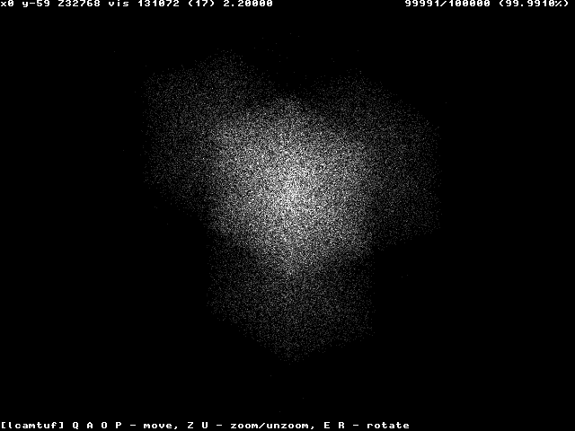
Windows 2000/XP

Slide 137
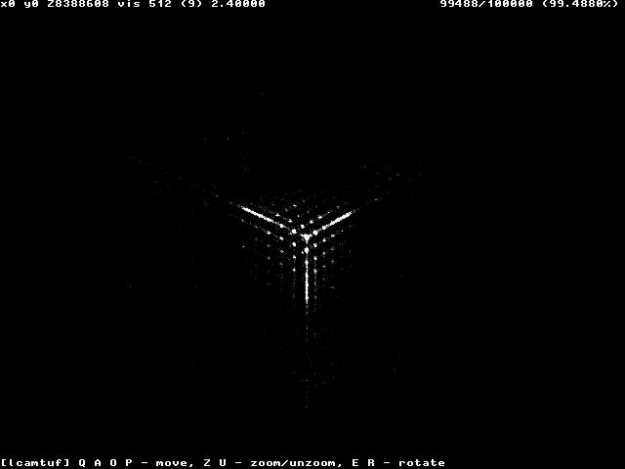
Windows 95/98

Slide 138
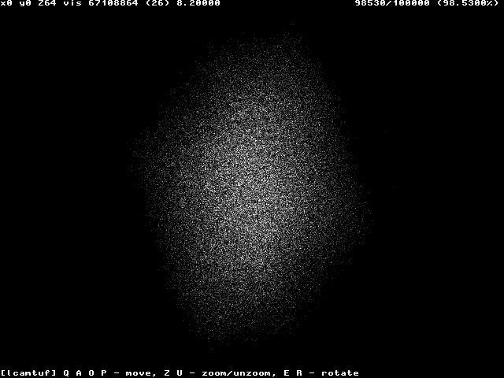
Linux

Slide 139
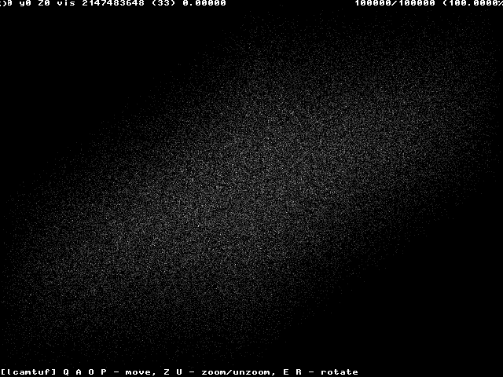
Free BSD

Slide 140
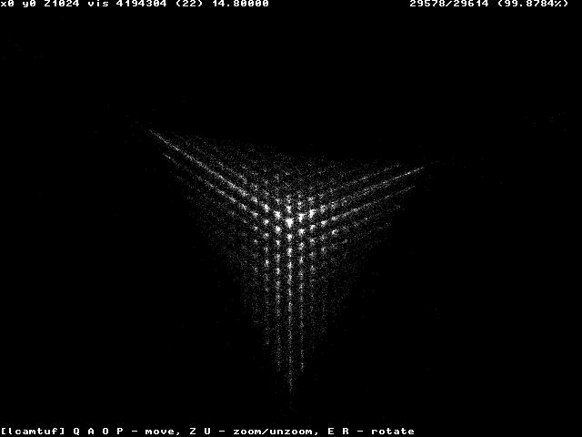
Cisco IOS Before The Cure

Slide 141
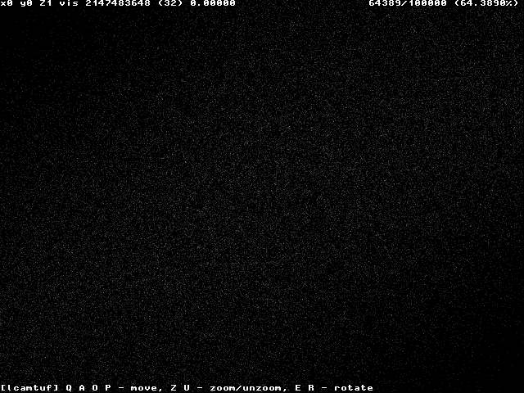
Cisco IOS After The Cure

Slide 142
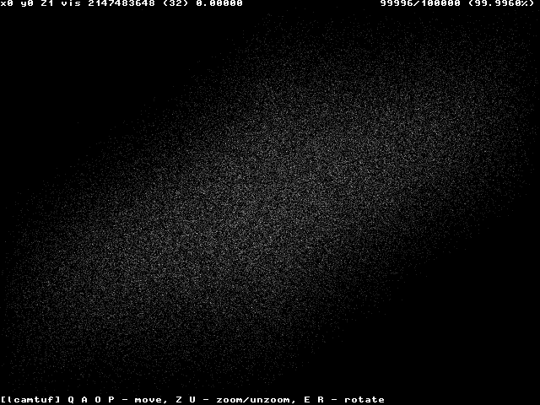
MacOS X

Slide 143
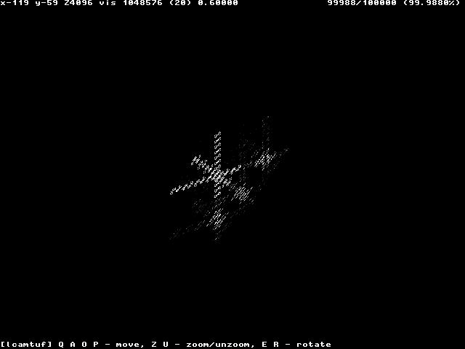
HP-UX Before The Cure

Slide 144
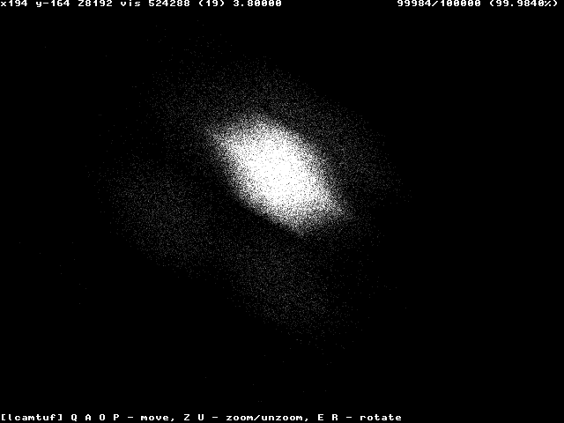
HP-UX After The Cure

Slide 145
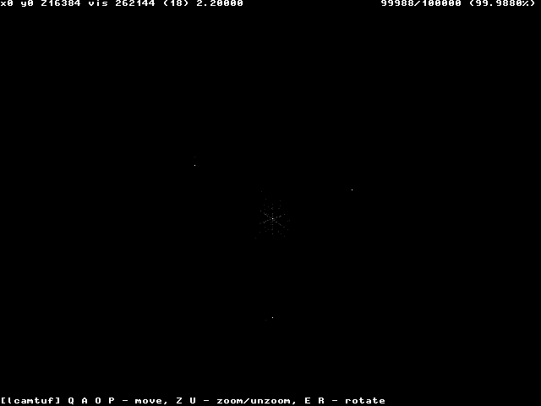
IRIX (w/out MD5 generation)

Slide 146
TCP Hijacking
Powerful technique to take control of an existing TCP connection
The attacker uses spoofed TCP segments to
Insert data in the streams
Reset an existing connection (denial of service)
The correct sequence/acknowledgment numbers must be used
The attacker can eavesdrop the traffic between client and server
The attacker can guess the correct seq/ack numbers
Described in “A Simple Active Attack Against TCP” by L. Joncheray

Slide 147
TCP Hijacking
The attacker waits until the connection is “quiet”
All the transmitted data have been acknowledged (by both endpoints)
The attacker injects the data in the stream
“Desynchronizes” the connection
The receiver of the injected data sends an acknowledgment to the apparent sender
The apparent sender replies with an acknowledgement with the “expected” sequence number
The receiver considers this as out-of-sync and sends an an acknowledgement with the “expected” sequence number
....

Slide 148
TCP Hijacking
ACK messages with no data are not retransmitted in case of loss
The “ACK storm” continues until one message is lost
Any subsequent attempt to communicate will generate an ACK storm
ACK storms can be blocked by the attacker using ACK packets with the right numbers

Slide 149
TCP Hijacking
CL_SEQ = SVR_ACK
SVR_SEQ = CL_ACK
(3) Acknowledge SEQ=CL_SEQ!
(2) ACK=CL_SEQ + 30
(1) Spoofed TCP
with SEQ=CL_SEQ
and 30 bytes of data
Client
Server
Attacker

Slide 150
TCP Hijacking
This technique can be used against both client and server to completely hijack the communication channel (man-in-the-middle attack)

Slide 151
ACK Storm
192.168.1.10.1026 > 192.168.1.20.23: P 1015112:1015133(21) ack 4056578923
192.168.1.20.23 > 192.168.1.10.1026: . seq 4056578923 ack 1015133
192.168.1.10.1026 > 192.168.1.20.23: . seq 1015112 ack 4056578923
192.168.1.20.23 > 192.168.1.10.1026: . seq 4056578923 ack 1015133
192.168.1.10.1026 > 192.168.1.20.23: . seq 1015112 ack 4056578923
192.168.1.20.23 > 192.168.1.10.1026: . seq 4056578923 ack 1015133
192.168.1.10.1026 > 192.168.1.20.23: . seq 1015112 ack 4056578923
192.168.1.20.23 > 192.168.1.10.1026: . seq 4056578923 ack 1015133
192.168.1.10.1026 > 192.168.1.20.23: . seq 1015112 ack 4056578923
192.168.1.20.23 > 192.168.1.10.1026: . seq 4056578923 ack 1015133
192.168.1.10.1026 > 192.168.1.20.23: . seq 1015112 ack 4056578923
192.168.1.20.23 > 192.168.1.10.1026: . seq 4056578923 ack 1015133
192.168.1.10.1026 > 192.168.1.20.23: . seq 1015112 ack 4056578923
192.168.1.20.23 > 192.168.1.10.1026: . seq 4056578923 ack 1015133
192.168.1.10.1026 > 192.168.1.20.23: . seq 1015112 ack 4056578923
192.168.1.20.23 > 192.168.1.10.1026: . seq 4056578923 ack 1015133
192.168.1.10.1026 > 192.168.1.20.23: . seq 1015112 ack 4056578923

Slide 152
TCP Hijacking Variants
“Early desynchronization” can be achieved by the attacker by resetting existing connections and immediately opening new ones (between the same ports) with different initial sequence numbers
In a “veto attack” the attacker predicts the size of the next packet that will be sent by the victim: by sending a packet with exactly the same size, it is possible to avoid the ack storm

Slide 153
SYN-flooding Attack
Very common denial-of-service attack, aka Neptune
Attacker starts handshake with SYN-marked segment
Victim replies with SYN-ACK segment
Attacker… stays silent
Note that the source IP of the attacker can be spoofed, since no final ACK is required
A host can keep a limited number of TCP connections in half-open state. After that limit, it cannot accept any more connections

Slide 154
SYN-flooding Attack
Current solutions
Filtering
Increase the length of the half-open connection queue
Reduce the SYN-received timeout
Drop half-open connections when the limit has been reached and new requests for connection arrive
Limit the number of half-open connections from a specific source
Use SYN cookies
See TCP SYN Flooding Attacks and Common Mitigations, RFC 4987

Slide 155
SYN Cookies
Special algorithm used for determining the initial sequence number of the server
The number is
Top 5 bits: t mod 32, where t is a 32-bit time counter that increases every 64 seconds
Following 3 bits: the encoding of the Maximum Segment Size (MSS) chosen by the server in response to the client's MSS
A keyed hash of:
Counter t
Source/Destination IP addresses and ports

Slide 156
SYN Cookies
A server that uses SYN cookies sends back a SYN+ACK, exactly as if the SYN queue had been larger
When the server receives an ACK, it checks that the secret function works for a recent value of t, and then rebuilds the SYN queue entry (using the encoded MSS info)
Drawbacks:
The server sequence number grows faster than normal
The MSS value is limited by the encoding procedure (only 8 possible values)
No data can be included in the initial SYN

Slide 157
State Attacks
There are other attacks that exploit the fact that the server has to maintain a certain amount of memory/resources associated with each open TCP connection
Memory for the socket descriptor
Process or thread to manage the connection
Memory associated with the data in the TCP stream that has not yet been acknowledged
…

Slide 158
IPv6
New version of the IP protocol
Introduced to solve major problems with IPv4
Shortage of IP addresses
Increase of routing information
End-to-end communication disruption caused by NAT-ing (which is often used to deal with the IP address shortage)
Uses 128-bit addresses
Supports better routing, QoS, extended options, security

Slide 159
IPv6 Header
0
8
16
24
31
Version
Traffic Class
Flow Label
Payload Length
Next Header
Hop Limit
Source Address (128 bits)
Destination Address (128 bits)

Slide 160
IPSec
Security built into the IP layer
Part of the IPv6 standard
Can be used as an extension to IPv4
Supports gradual transition from IPv4 to IPv6
Provides authentication and confidentiality
Provides support for Virtual Private Networks (VPNs)
Defines infrastructure for key management

Slide 161
Basic Concepts
Security association (SA)
A security association is defined before starting to communicate
The security association specifies the security parameters for a particular communication channel
Algorithms used for authentication
Algorithms used for bulk encryption
Validity of the association
Each IP datagram contains a reference (Security Parameter Index) to the relevant SA
Authentication Header (AH)
Extension that provides authentication and integrity with HMAC
Encapsulating Security Payload (ESP)
Extension that provides confidentiality

Slide 162
Authentication Header
0
8
16
24
31
Next header
Payload length
Reserved
Security parameter index (SPI)
Sequence number
Authentication data

Slide 163
Encapsulating Security Payload
0
8
16
24
31
Security parameter index (SPI)
Sequence number
Payload
Padding
Pad length
Next header
Authentication data

Slide 164
Some Confusion…
Initially:
AH only for authentication and integrity checking
ESP only for confidentiality
AH + ESP for all of the above
Some flaws were found when ESP alone is used
Protocol extended
Currently:
AH if only authentication and integrity checking are required
ESP for confidentiality, authentication, and integrity

Slide 165
Modes
Transport mode
Use in host-to-host communication
AH authenticates parts of the IP header and the whole payload
ESP used to encrypt the IP payload
Tunnel mode
The original datagram is encapsulated in another datagram
AH authenticates the encapsulated IP datagram plus parts of the header of the encapsulating datagram
ESP used to encrypt the encapsulated datagram

Slide 166
Internet Key Exchange
Prior to an IP datagram being exchanged between two hosts, a Security Association must be in place
SAs can be created manually or dynamically using the IKE
The IKE is based on the Internet Security Association and Key Management Protocol (ISAKMP)
Usually IKE is performed by a daemon

Slide 167
IPv6 Security Risks
IPv6 provides better security than IPv4
Some network security tools that are not able to handle IPv6
IPv6 traffic can be used to avoid detection
Suggested reading: “IPv6 Security: Attacks and Countermeasures in a Nutshell”, in Proceedings of WOOT, 2014

Slide 168
Wireless Networks
Wireless networks allow to exchange network packets over a radio link
Protocols are defined in the 802.11 standard series
802.11 supports bit rates up to 2 Mbps
802.11b-g provides bit rates up to 11 Mbps (2.4 GHz band)
802.11a provides bit rates up to 54 Mbps (5 GHz band)
802.11n uses both 2.4GHz and 5GHz bands for a bit rate of 600 Mb/s
802.11ac provides bandwidth up to 3.5 Gb/s
802.11ad provides bit rates up to 6.75 Gb/s (60 GHz band)

Slide 169
802.11 Data Link Layer
Logical Link Control (LLC) layer shared with other 802 lans (48-bit addresses)
Different Media Access Control (MAC)
Wired Ethernet uses Carrier Sense Multiple Access with Collision Detection (CSMA/CD)
Near/far problem radio transmission does not allow a station to listen for collisions
Stronger signals make weaker signals become noise
WLAN: Carrier Sense Multiple Access with Collision Avoidance (CSMA/CA)

Slide 170
CSMA/CA
Station A waits for “no activity”
Station A waits for a random amount of time
Station A starts sending
Station B sends an ACK
If station A does not receive a valid ACK
It assumes that the packet was lost or the ACK was lost
The packet is retransmitted after a random amount of time
Robustness features
Ready To Send/Clear To Send (RTC/CTS)
CRC checksums

Slide 171
Modes of Operation
Infrastructure mode
Wireless access point (AP) connected to wired network
Mobile stations with wireless cards
Ad hoc mode
Mobile stations with wireless cards
Traffic not directed to in-range hosts must be routed by a mobile station

Slide 172
Type of Frames
Management frames
Authentication frames
Open networks require a simple request-response
Networks protected by shared-key authentication require a number of steps in order to authenticate the client
De-authentication frames
Association request/response frames
Disassociation frames
Beacon frames
Probe request/response frames

Slide 173
Type of Frames
Control frames
RTS/CTS frames
ACK frames
Data frames

Slide 174
Association
Clients (also called “stations”) associate with an access point (AP)
Access points are identified by a service set identifier (SSID)
When a mobile station enters the transmission range of one or more Aps, it will connect to the station with the strongest signal (and lowest observed error rate)
Periodically it will scan the network for better APs
MAC Access Control Lists can be used to regulate which stations can associate with an AP

Slide 175

Discovery - Open Network
Node
Access Point
Beacon (w/ SSID)
May check if
SSID matches
Association Request
Association Response
Accepts Node
Node is Associated

Slide 176
Discovery - Closed Network
Node
Access Point
Probe Request
Knows SSID
SSID matches
Probe Response
Association Request
Access point
accepts node
Association Response
Node is associated

Slide 177
Wired Equivalent Privacy
Wired Equivalent Privacy (WEP) is a series of mechanisms to provide security
Encryption with shared-key can be used to encrypt traffic
RC4 with 40-bit or 104-bit static key, 24-bit IV in the clear
This protocol is broken

Slide 178
WPA
Wi-Fi Protected Access (WPA) was introduced to solve the security problems associated with WEP
Implements a subset of the 802.11i standard
Relies on TKIP (Temporal Key Integrity Protocol), which uses a per-packet key
Secret key and initialization vector for RC4 are composed in a complex way and not simply juxtaposed
Keys are routinely changed
A sequence number is added to prevent replay attacks
Introduces a message integrity check (Michael) that is better than WEP’s CRC
WPA supports authentication mechanisms, such as 802.1X - EAP/Radius
WPA does not rely on additional hardware and therefore can be used on hardware that supports WEP

Slide 179
WPA2
A number of vulnerabilities have been found in WPA
See for example: M. Vanhoef and F. Piessens “Practical Verification of WPA-TKIP Vulnerabilities,” in Proceedings of ASIACCS, 2013
WPA/TKIP was deprecated by IEEE in 2009
WPA2 is the evolution of WPA implements the full 802.11i standard
Requires new hardware
Uses AES instead of TKIP
Supports both pre-shared key (PSK) and extended authorization (802.1X - EAP/RADIUS)

Slide 180
Attacks Against Wireless Networks
Wireless traffic sniffing
Wireless network detection
Closed networks
Injection attacks
Denial of service
Man-in-the-middle
WEP attacks
Stream reuse attacks
WEP traffic generation
Brute force attacks
FMS attack

Slide 181
Wireless Traffic Sniffing
Traffic in an open wireless network is particularly vulnerable to eavesdropping
No physical access is necessary (e.g., the “parking lot attack”)
Even when using encryption, source and destination MAC addresses are accessible
May be used to bypass MAC access control lists at another AP, configured differently (e.g., no encryption)
May be used to perform traffic flow analysis

Slide 182
Monitor vs. Promiscuous
In promiscuous mode, the 802.11 headers are removed and only the packets transmitted by the AP with whom the client is associated are passed on by the driver
In order to observe all traffic (including management frames) the network card must be able to be in monitor mode (RFMON)
When in monitor mode, the card (usually) cannot send traffic

Slide 183
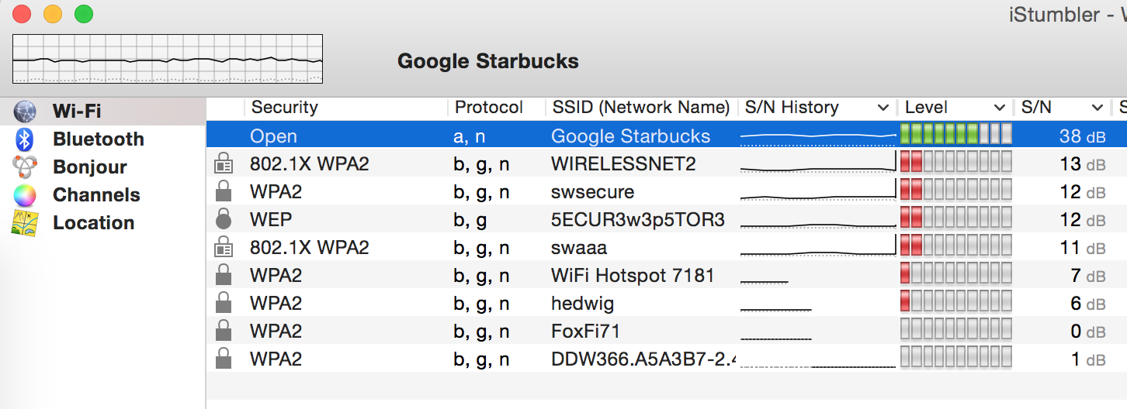
Wireless Network Detection
Monitor Mode Protocol Analysis
Card set to monitor mode
Sniffs beacons and probes
Allows one to detect closed APs
Allows one to detect wireless nodes

Slide 184
Detecting Closed Networks
Analyze probe responses from APs that are replies to probe requests from valid nodes
Probe requests are sent out roughly every 10 minutes
Probe requests can be forced using a disassociation attack
Attacker sends a spoofed disassociation frame pretending to be the AP
The disassociated station tries to connect again and sends a probe message (containing the SSID)

Slide 185
Denial of Service
Wireless networks are particularly vulnerable to denial-of-service attacks
One can send a disassociation request to nodes on a wireless network and continue to send disassociation messages whenever they re-associate
One can use radio interference to make the wireless network unusable

Slide 186
Man-in-the-Middle Attacks
There are two main ways to perform a man-in-the-middle attacks:
By performing ARP spoofing once associated with an AP
By de-authorizing a victim host
Attacker becomes an AP with the same SSID on a different channel
Attacker de-authorizes victim
Victim reconnects to fake AP
Attacker relays frames back and forth

Slide 187
1.Open System Authentication
Establishing the IEEE 802.11 association with no authentication
STA
AP STA
Probe Request
Probe Response
Open System Authentication Request
(STA Identity)
Open System Authentication Response
Association Request
Association Response

Slide 188
2. Wired Equivalent Privacy (WEP)
WEP uses shared key authentication
STA
AP STA
Probe Request & Probe Response
Shared Key Authentication (1)
(STA Identity)
Shared Key Authentication (2)
Challenge
Encrypted(Shared Key Authentication (3)
Challenge)
Shared Key Authentication (4)
(Success/Failure)
Association Request & Response

Slide 189
WEP Encryption
A shared secret key K (40 or 104 bits) and a public IV (24 bits) are used to generate a stream of pseudo-random bits using RC4
The message includes a CRC code computed on the plain text part of the message
The stream is XORed with the message
The message and the IV are sent to the receiver
A different IV is used every time
At the receiving end, the IV and the shared key are used to generate the same bit stream, which is then XORed with the encrypted message

Slide 190
2. Wired Equivalent Privacy (WEP)
WEP Encryption uses RC4 stream cipher
IV
IV
Seed
RC4
PRNG
Key Stream
Concatenation
+
Cipher
Text
WEP KEY
Plaintext
Concatenation
Message
CRC-32
Integrity Check Value (ICV)

Slide 191
2. Wired Equivalent Privacy (WEP)
Several major problems in WEP security
The IV used to produce the RC4 stream is only 24-bit long
The short IV field means that the same RC4 stream will be used to encrypt different texts – IV collision
Statistical attacks can be used to recover the plaintexts due to IV collision
The CRC-32 checksum can be easily manipulated to produce a valid integrity check value (ICV) for a false message

Slide 192
WEP Attacks
Brute Force
Brute forcing a 40-bit key is feasible
Key stream reuse
If a key stream is reused, it is possible to obtain the XOR of two plaintext messages
(M1 ^ Si) ^ (M2 ^ Si) = M1 ^ M2 ^ Si ^ Si = M1 ^ M2
If one of the messages is known, it is possible to derive the other or the key stream for the IV,K used
The Shared Key Authentication mechanism worked by providing a plaintext challenge that the client had to encrypt to prove that it knew the password
This allows one to collect some bits of that particular cypher stream
Weak integrity check
Because the CRC is computed on the plaintext it is possible to modify the cipher text without breaking the CRC

Slide 193
WEP Attack Countermeasures
Closed Mode
MAC Filtering
Use Weak IV Filtering Hardware
Keys Rotation

Slide 194
Closed Mode
Strengths
Doesn’t send out any beacon frames (more difficult to detect)
Requires connecting nodes to supply the correct SSID in order to associate
Weaknesses
AP can still be detected through sniffing probe requests and responses

Slide 195
MAC Filtering
Strengths
Allows one to control which MAC addresses can associate with an access point
Weaknesses
MAC addresses can be easily spoofed
One can easily determine which MAC addresses are allowed by monitoring activity on the network
Attackers can still monitor communications
One can easily brute force MAC addresses

Slide 196
Weak IV Filtering Hardware
Strengths
It requires much more time for an attacker to crack the WEP key
Weaknesses
An attacker can still crack the WEP key given enough time

Slide 197
Change Keys Frequently
Strengths
Makes it more difficult for attackers to crack WEP
Even if an attacker cracks a key, they will only have access for a limited amount of time
Weaknesses
With traffic generation, an attacker can crack a key in a reasonable amount of time
Attackers can still decrypt collected traffic using cracked keys

Slide 198
3. Robust Security Network (RSN)
802.11i defines a set of features to establish a RSN association (RSNA) between stations (STAs)
Enhanced data encapsulation mechanism
CCMP
Optional: TKIP
Key management and establishment
Four-way handshake and group-key handshake
Enhanced authentication mechanism for STAs
Pre-shared key (PSK); IEEE 802.1x/EAP methods

Slide 199



3. Robust Security Network (RSN)
Operational phases
Authentication Server
Station
Access point
Security Capabilities
Discovery
802.1x authentication
RADIUS/EAP
802.1x Key
Management
RADIUS-based
Key Distribution
Data Protection

Slide 200
3. Robust Security Network (RSN)
Discovery message exchange
Station
Access point
Probe Request
Probe Response + RSN IE
802.11 Open System Auth.
802.11 Open System (success)
Association Requst + RSN IE
Association Response (success)

Slide 201
3. Robust Security Network (RSN)
Authentication
Mutual authentication
The AS and station derive a Master Key (MK)
A Pairwise Master Key (PMK) is derived from MK
The AS distributed PMK to the AP
In PSK authentication, the authentication phase is skipped
PMK = PSK

Slide 202
3. Robust Security Network (RSN)
Key management and establishment
PMK is sent to AP by AS
Key management is performed between AP and the peer – four-way handshake
The four-way handshake can also be used for mutual authentication between AP and the peer in PSK mode
A set of keys are derived from PMK to protect group key exchange and data
Group key exchange allows AP to distribute group key (for multicast) to the peer

Slide 203
4. Temporal Key Integrity Protocol (TKIP)
Optional IEEE802.11i protocol for data confidentiality and integrity
TKIP is designed explicitly for implementation on WEP legacy hardware
TKIP three new features:
A cryptographic message integrity code (MIC)
A new IV sequencing discipline
The transmitter increments the sequence number with each packet it sends
A per-packet key mixing function

Slide 204
4. Temporal Key Integrity Protocol (TKIP)
TKIP frame processing
Temporal
key
Transmitter
address
TKIP sequence counter (TSC)
MIC
key
Source & destination addresses, priority, and payload
Phase 1
Key mixing
TSC2-TSC5
MICHAEL
TTAK
Frame payload + MIC
Phase 2
Key mixing
TSC0-TSC1
Fragmentation
(if required)
TSC0-TSC5
WEP IV
WEP secret key
Clear text frames
Encrypted and authenticated frames for transmission
WEP Processing

Slide 205
4. Temporal Key Integrity Protocol (TKIP)
Defeating weak key attacks: key mixing
Transforms a temporal key and packet sequence number into a per packet key and IV
The key mixing function operates in two phases
Phase 1: Different keys used by different links
Phase 1 needs to be recomputed only once every 2¹⁶ frames
Phase 2: Different WEP key and IV per packet
Phases 1 and 2 can be pre-computed

Slide 206
3. Temporal Key Integrity Protocol (TKIP)
Defeating replays: IV sequence enforcement
TKIP uses the IV field as a packet sequence number
The transmitter increments the sequence number with each packet it send
A packet will be discarded if it arrives out of order
A packet is out-of-order if its IV is the same or smaller than a previous correctly received packet
Defeating forgeries: New MIC (Michael)
MIC key is 64-bits
security level of 20 bits

Slide 207
4. Temporal Key Integrity Protocol (TKIP)
TKIP encapsulation
Encrypted
4
4
8
4
4
MAC
Header
IV/Key
ID
Extended
IV
Data
MIC
WEP
ICV
FCS
TSC1
WEP
Seed
TSC0
Rsvd Ext IV Key ID
TSC2
TSC3
TSC4
TSC5

Slide 208
5. Counter Mode with CBC-MAC (CCMP)
Both encryption and MIC use AES
Uses counter Mode (CTR) to encrypt the payload and MIC
Uses CBC-MAC to compute a MIC on the plaintext header and the payload
Both encryption and authentication use the same key
Encryption
Header Payload MIC
Authenticated

Slide 209
5. Counter Mode with CBC-MAC (CCMP)
CCMP data processing
Temporal
key
Key
Id
Plaintext frame
Packet #
MAC header
Data
A2
Additional
authentication
data
Create
nonce
CCMP
header
CCM encryption
MAC
header
CCMP
header
Data
MIC
FCS

Slide 210
5. Counter Mode with CBC-MAC (CCMP)
Each message block has the size of 16 octets
For CTR encryption, A_{i} has the following format (i is the value of the counter field):
For the CBC-MAC authentication, B₀ has the following format (length := size of the payload):
1
13
2
Flags Nonce Counter
1
13
2
Flags Nonce length

Slide 211
5. Counter Mode with CBC-MAC (CCMP)
CCM encryption
E
+
. . .
+
E
+
. . .
+
E
B₀
B₁
. . .
B_{k}
0
B_{k+1}
. . .
B_{N}
0
Header
Payload
MIC
+
Encrypted
MIC
+
Encrypted payload
S₁
. . .
S_{M}
S₀
A₁
E
. . .
A_{M}
E
A₀
E

Slide 212
6. Key Management and Establishment
802.1x key management
Use RADIUS to push PMK from AS to AP
Use PMK and 4-way Handshake
To derive, bind, and verify PTK
Use Group Key Handshake to send GTK from AP to station

Slide 213
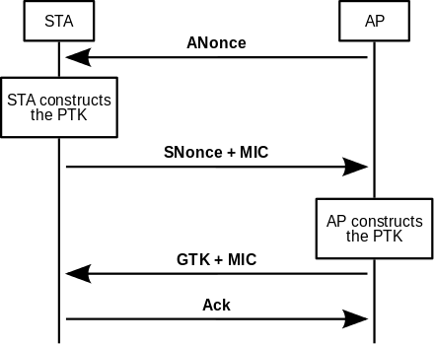
WPA2 4-way Exchange
The AP sends to the client an Anonce
The Client derives the Pairwise Transient Key (PTK) from Anonce, Snonce, and PMK and sends the Snonce protected by a Message Integrity Code (MIC) calculated using the PTK
AP also calculates the PTK and verifies the MIC. Then the AP sends the Group Transient Key (GTK)
The Client receives the GTK and sends an acknowledgment
https://en.wikipedia.org/wiki/IEEE_802.11i-2004

Slide 214
6. Key Management and Establishment
Group Key Handshake
Pick random GNonce
Encrypt GTK with KEK
EAPoL-Key(MIC, encrypted(GTK))
Decrypt GTK
EAPoL-Key(MIC)
Unblocked data traffic
Unblocked data traffic

Slide 215
7. Authentication protocols
Authentication overview
802.1x/EAP-Request
Identity
802.1x/EAP-Response
Identity (EAP type specific)
RADIUS Access
Request/Identity
EAP type specific mutual authentication (e.g. EAP_TLS)
Derive Pairwise Master key (PMK)
Derive Pairwise Master key (PMK)
RADIUS Accept (with PMK)
802.1x/EAP-Success

Slide 216
7. Authentication Protocols
Authentication components
Station
Access point
Authentication
Server
Authentication Method (e.g. EAP-TLS)
EAP
802.1x (EAPoL)
RADIUS
802.11
UDP/IP

Slide 217
7. Authentication Protocols
LEAP
Simple – neither server certificate or peer certificates is required
CHAP is used for mutual authentication
The user’s password is the shared secret
Session key is derived from the shared secret , the challenges and the challenge responses
Susceptible to the dictionary attack

Slide 218
7. Authentication Protocols
EAP authentication: general approach
Used TLS to setup a secure tunnel
Inner authentication method is used for further authentication
IEEE 802.1x
/EAP
RADIUS
/EAP
master secret
TLS
master secret
[Inner EAP Authentication]
PMK = function of (nonces, {DH secret/session key})

Slide 219
7. Authentication Protocols
EAP-TLS
Both peer and AS authenticate each other using certificates in the TLS phase
Inner authentication may be used for user authentication
IEEE 802.1x
/EAP
RADIUS
/EAP
master_secret
TLS
master_secret
[user/pwd, MD5 challenge, TLS, …]
master_secret = PRF(pre_master_secret, “ master secret”, nonces)
PMK = PRF(master_secret, “client EAP encryption”, nonces)

Slide 220
7. Authentication Protocols
PEAP
At the TLS phase, server is authenticated based on the server’s certificate – no peer authentication
Peer authentication is done at the inner authentication
EAP-MS-CHAPV2 is the most popular inner authentication method – it provides mutual authentication plus key generation
The PMK generated is based on both the TLS master_secret and the master_session_key (MSK)

Slide 221
7. Authentication Protocols
EAP-FAST
Two methods for setting up TLS tunnel
Server certificate
Protected Access Credential (PAC)
PAC components:
Shared secret – used to derive TLS master secret
opaque element – presented by the peer to the AS
Contains shared secret and peer identity
Protected with cryptographic keys and algorithm
other information – identity of the PAC issuer, secret lifetime …

Slide 222
7. Authentication Protocols
TLS tunnel using PAC
IEEE 802.1x
/EAP
RADIUS
/EAP
PAC-key
PAC-opaque
ClientHello, PAC-opaque
DE(PAC-opaque) =
(PAC-key, peer ID,...)
ServerHello, ChangeCipherSuite, Finished
master_secret
master_secret
ChangeCipherSuite, Finished
[Inner Authentication]
MSk
MSk
master_secret = PRF(PAC-key, “PAC to master secret label hash”, nonces)
PMK = function of (master_secret, MSK)

Slide 223
Traffic Generation To Help WEP Cracking
The Caffe Latte approach was introduced to force the generation of traffic
Pretends to be a WEP-enabled AP with the SSID of a previously-joined AP
Records encrypted gratuitous ARP packets sent by client at connection
Modifies the ENCRYPTED packet so that it becomes an ARP request
Re-injects the packet and create the traffic
Allows one to recover a 104-bit key in around six minutes

Slide 224
WPA2 Attacks
WPA2 does not have known serious vulnerability
It is still open to a password guessing attack
The attacker de-authenticates a connected user
The user re-authenticates using a four-step handshake containing the encrypted password
The four handshake is recorded and used offline to try a number of passwords (dictionaries, random permutation, etc.)
Under certain conditions, the protocol is vulnerable to a key reinstallation attack

Slide 225
WPA2 4-way Exchange
Both Client and AP know a Pairwise Master Key (PMK), derived by the PSK (Pre-Shared Key)
Note that if the network is using 802.1X, the PMK is based on the data associated with the user authentication process and the PSK, otherwise the PMK is the PSK
The exchange is protected using the PMK
If one knows the Pre-Shared Key and observes the 4-way handshake he/she will be able to decrypt the traffic between the client and the access point

Slide 226
WPA2 4-way Exchange
The AP sends to the client an Anonce
The Client derives the Pairwise Transient Key (PTK) from Anonce, Snonce, and PMK and sends the Snonce protected by a Message Integrity Code (MIC) calculated using the PTK
AP also calculates the PTK and verifies the MIC. Then the AP sends the Group Transient Key (GTK)
The Client receives the GTK and sends an acknowledgment
https://en.wikipedia.org/wiki/IEEE_802.11i-2004

Slide 227
The KRACK Attack
An attacker “clones” the AP (MAC address need to be the same) on a different channel
If the attacker’s signal is stronger than the original AP, the client will connect to the cloned AP
The attacker acts as a man-in-the-middle forwarding the first three steps of the 4-step handshake, but blocking the 4th step
At this point the client resets its nonce counter, and starts sending traffic

Slide 228
The KRACK Attack
The original AP does not see the 4th message, and re-sends the third message of the protocol
The attacker intercepts this message and forwards it to the client
The client accepts this message and re-resets its counter, causing the reuse of specific nonces
See: “Key Reinstallation Attacks: Forcing Nonce Reuse in WPA2” in Proceeding of ACM CCS, 2017

Slide 229
Wardriving
Term that denotes the practice of driving around looking for open access points
Pun on “wardialing”, which is the practice of trying a large number of telephone number looking for modems/terminal servers (see “Wargames” -- the movie)
Equipment
Laptop with wireless card (and possibly external antenna)
GPS device to provide geographical information

Slide 230
Detecting Wardrivers
Wardrivers can be detected by recognizing specific wardriving tool signatures
Kismet has a module to detect NetStumbler probes
Wardrivers can be detected by identifying a suspiciously high number of probes
Passive detection cannot be detected
The position of wardrivers can be determined using triangulation techniques on the strength of the signal

Slide 231
Summary
Networks are used to exchange data between nodes
It is important to understand what can and cannot be trusted
Attack building blocks
Sniffing
Spoofing
Hijacking
Denial-of-service
Brute-forcing
Tools
Countermeasures

Slide 232
Appendix: VxWorks
https://www.armis.com/urgent11/

